Slide 1
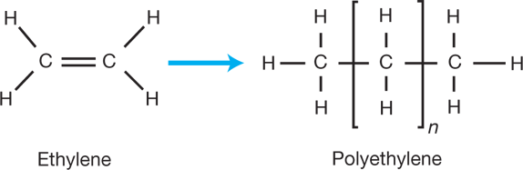
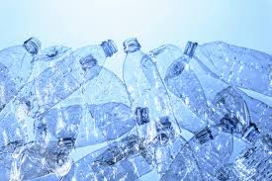
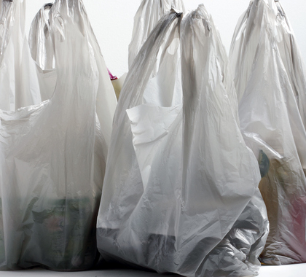
Reaction of the Day: Polyethylene
Polyethylene is the most commonly used plastic in the world and can be made to have diverse properties.
Over 90 million metric tons of polyethylene are produced globally each year.
Polyethylene is used in power transmission, food packaging, consumer goods, electronics, and household goods.
Polyethylene doesn’t biodegrade but does undergo photodegradation – light causes polyethylene chains to break, and so the pieces of plastic get smaller over time.
Plastics like polyethylene have even been found 36,000 feet deep in the Mariana Trench.
aiche.org
Sciencedirect.com
Strom, E. T.; Rasmussen (2011)
Nationalgeographic.com
Notes:
Herein, two sample lectures given by Chad Mirkin at Northwestern in a General Chemistry course are provided. The notes on these slides are meant to provide additional information and aid in accessibility. Note that these slides were utilized to enhance an advanced or modern materials module taught at the end of General Chemistry, but these slides could be adapted to integrate aspects of this content throughout the course in several lectures (minutes per lecture), more in the style discussed in the manuscript. In particular, the similarities and differences between traditional thermoset polymers and DNA (Lecture 1), electron-based bonding between atoms and DNA hybridization-based bonding between programmable atom equivalents (PAEs) (Lecture 2), and the packing of atoms in metallic and ionic solids and the assembly of nanoparticles in DNA-nanoparticle superlattices (Lecture 2) are highlighted.
This lesson begins with a “Reaction of the Day”’; an example reaction relevant to the topic of discussion for the lecture to illustrate the relevance of the General Chemistry lesson to daily life. Because this lesson focuses on polymers, the “Reaction of the Day” focuses on the synthesis of polyethylene.

Slide 2
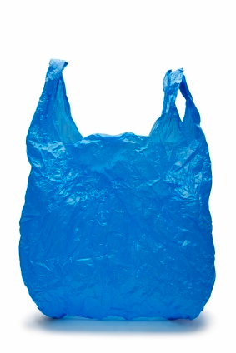
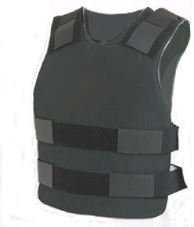

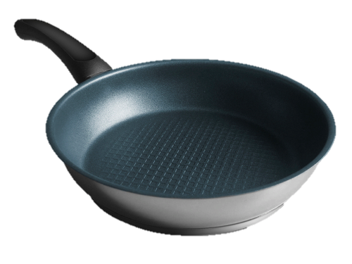
Today’s Overview
Polymers
  Addition Polymerization vs. Condensation Polymerization
  Cross-Linking
  Elastomers, Thermoplastics, Thermosets
What do these have in common?

Slide 3
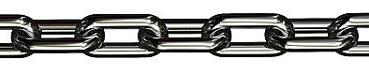
What are Polymers?
Polymer: Chain-like molecule composed of many (poly-) repeating structural units called monomers (-mers).
  Monomers can be any building block that connects together.
Natural Polymers:
  Rubber, leather, wool, DNA, proteins
Synthetic Polymers:
  Polyethylene, polypropylene, polyester, nylon, polyvinylchloride
Notes:
Following the overview slide, the lecture begins with a discussion of polymers common to the modern materials chapters of many General Chemistry textbooks. This traditional discussion of polymers will continue until Slide 15, where DNA, an important biopolymer, is introduced.

Slide 4
Structure of a Polymer (Kevlar)
  Terminal group.
  Terminal group:
  This is where the next monomer can be added.
  Number of monomers in a polymer chain.
  Repeating Unit (Monomer)
  Contained in Brackets

Slide 5
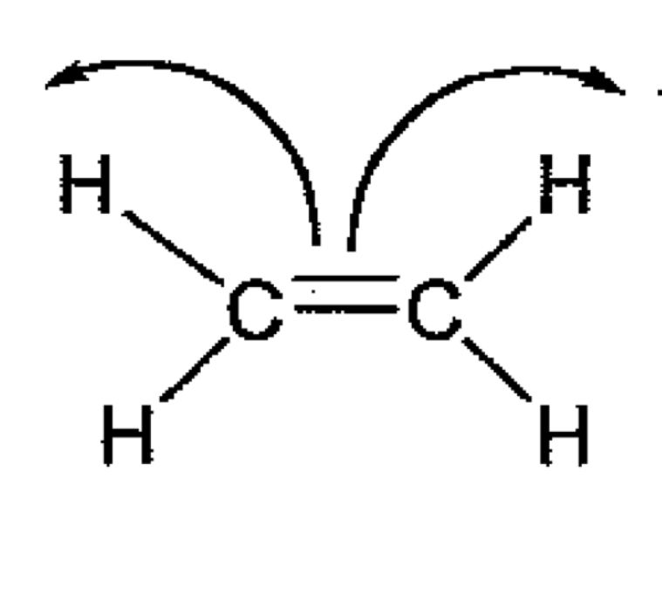
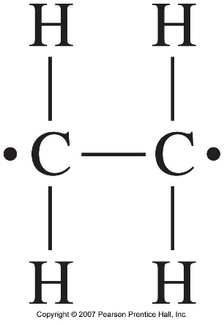
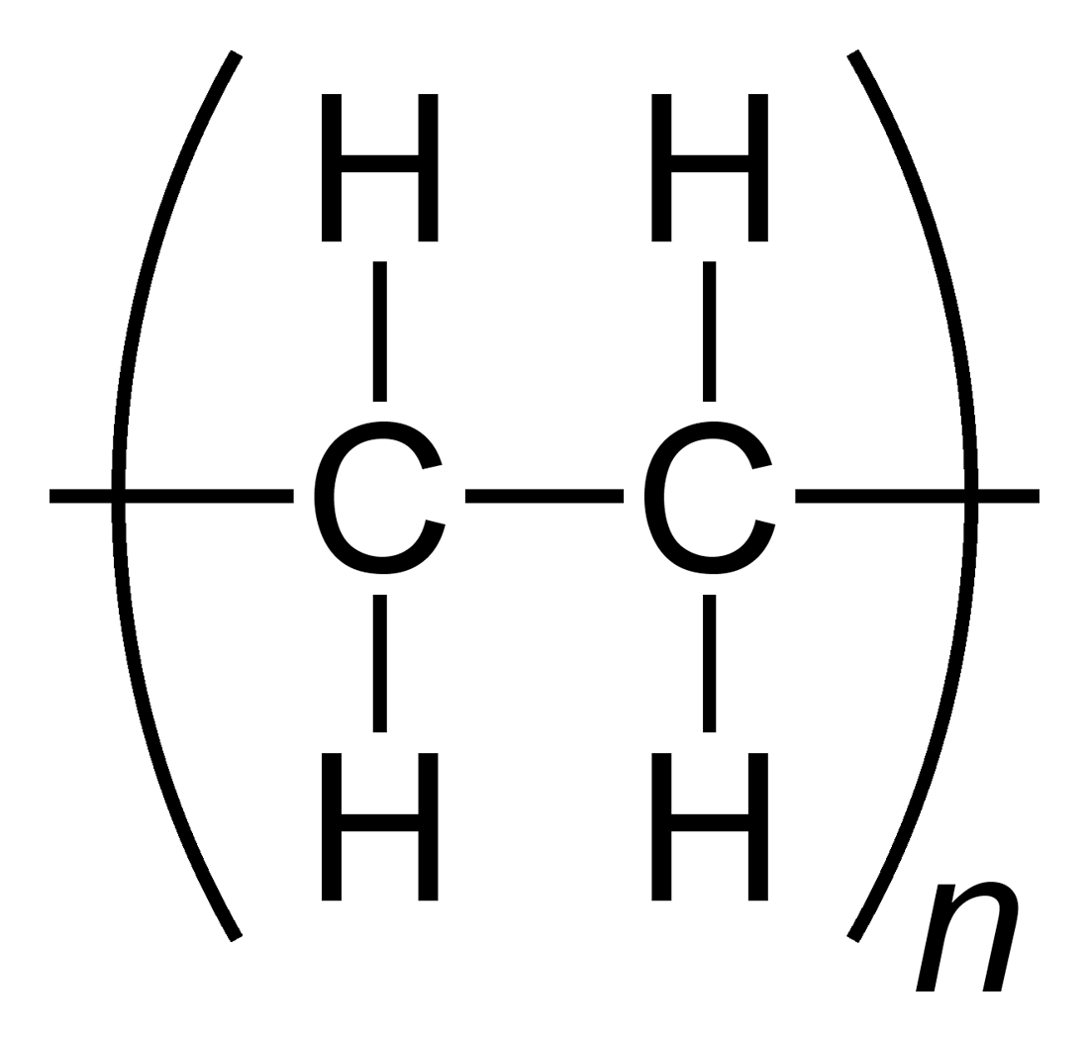
Addition Polymerization
(Chain-Reaction Polymerization)
Double bonds open up to form “radical” unpaired electrons at the end of each chain.
  Formation of a bond is more stable than unpaired electrons, therefore these continue to build in a chain-reaction.
ethylene
Radical Intermediate
polyethylene

Slide 6
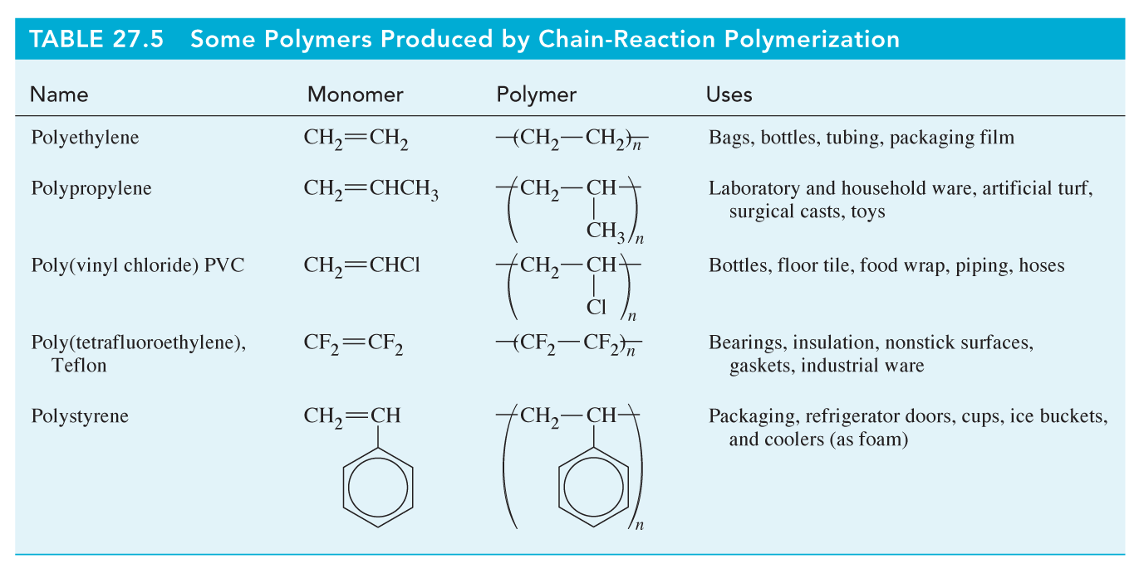
Common Addition Polymers
Petrucci, Harwood, Herring, Madura, General Chemistry

Slide 7
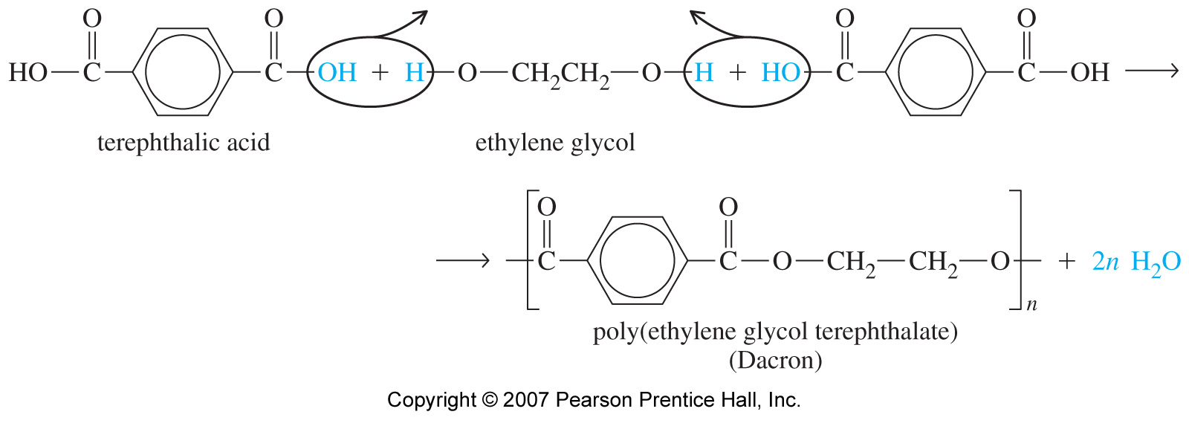
Condensation Polymerization
(Step-Reaction Polymerization)
Two molecules join together and often eliminate a small molecule such as H₂O.

Slide 8
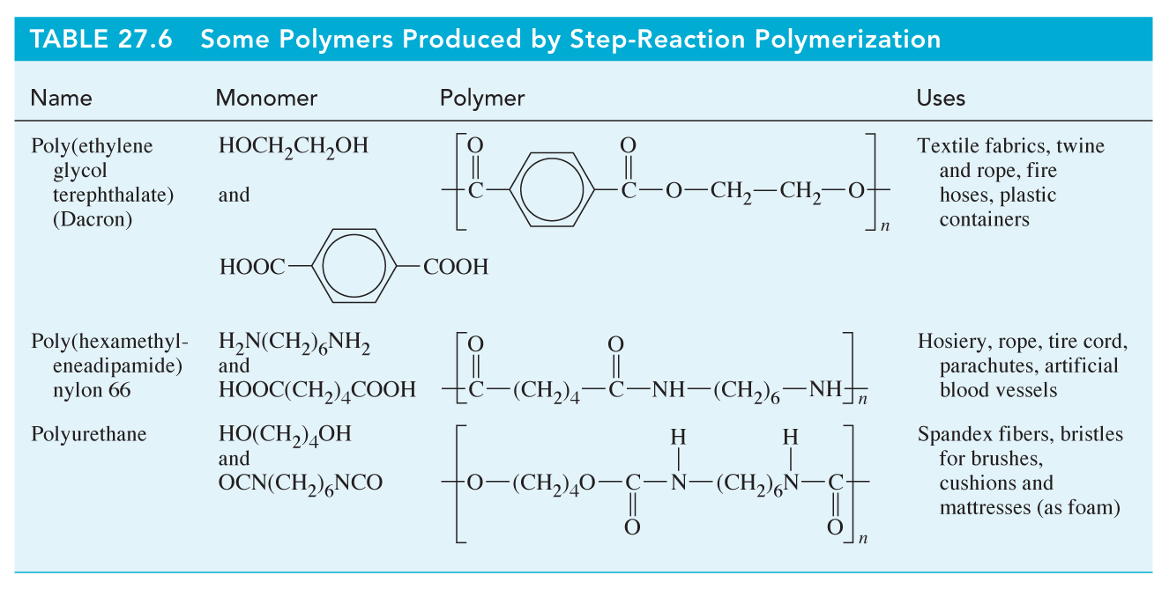
Common Condensation Polymers
Petrucci, Harwood, Herring, Madura, General Chemistry

Slide 9
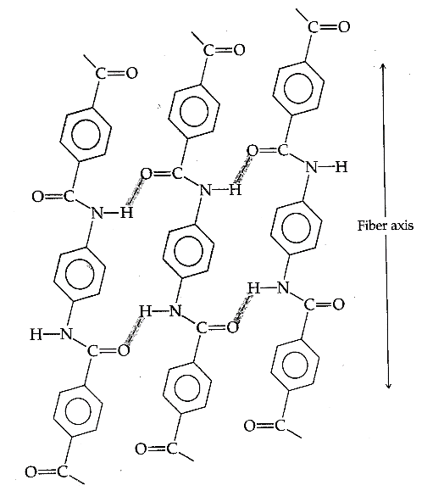
Cross-Linking Connects Polymer Chains via Covalent Bond Formation or IMFs
Covalent bond formation lends properties to polymer chains that are not seen in the chains alone.
  Example: Isoprene into rubber via vulcanization.
Intermolecular forces (hydrogen bonding, dipole interactions, and dispersion forces)
  Example: Nylon 6,6; Kevlar
Polymer types, based on these properties:
  Thermoplastic
  Thermoset
  Elastomer
Vulcanized Rubber
Kevlar

Slide 10
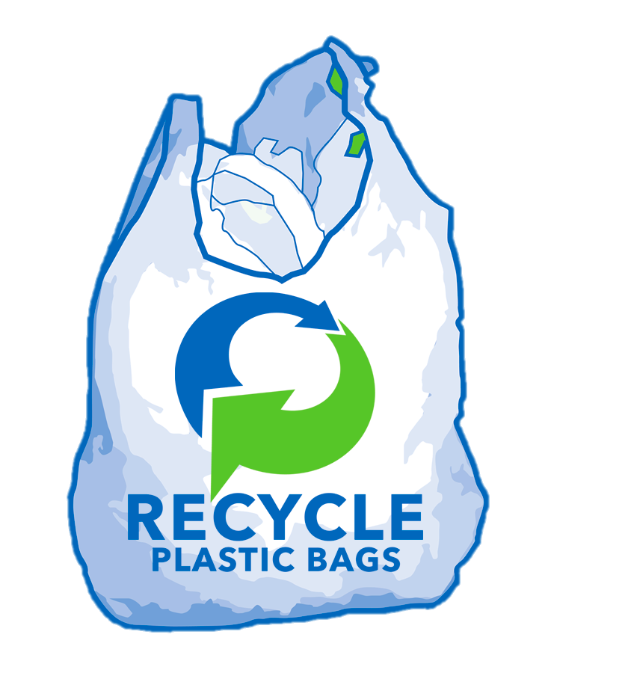

Thermoplastic Polymers Exhibit Temperature-Dependent Properties
Above critical temperature, become fluid, or “glassy”.
When cooled below critical temperature will retain shape of previous container.
  Reusable; Can be molded into new forms.
  Example: Polyethylene bags

Slide 11
Thermoset Polymers Exhibit Irreversible Cross-Linking with Heat
Above critical temperature, polymer undergoes irreversible cross-linking reaction.
Upon cooling, polymer retains final form.
Vulcanization of rubber
+
polyisoprene
sulfur
  Involves the formation of a chemical bond!

Slide 12
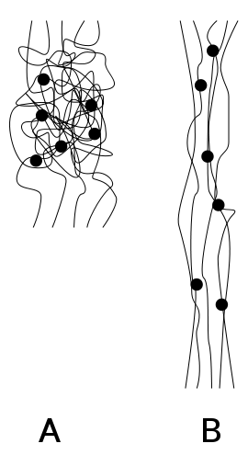
Cross-Linking in Elastomers Allows Reversible Stretching
Polymer reorganizes upon application of stress to redistribute force.
  Weak IMFs broken and re-formed to keep polymer chains associated with each other.
  Will return to previous shape if previously “cured” or covalently cross-linked (e.g., rubber).
  Can be thermosets or thermoplastics.
Before
Stress
Polymer
Location of Covalent Cross-Linking
After
Stress

Slide 13
Cross-Linking via Intermolecular Forces (IMFs)
Depending on the monomer identity, chains may exhibit hydrogen-bonding or dipole-dipole interactions.
  As the polymer size increases, dispersion forces will also become important.
IMFs can be used to cross-link chains; however, these can be broken more easily than cross-linking via covalent bond formation.
  Example: Kevlar

Slide 14

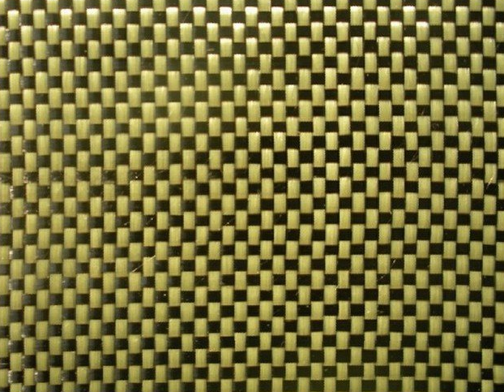
Cross-Linking of KevlarTM Molecules via Intermolecular Forces
Kevlar fibers, connected via intermolecular forces, are woven into fabrics for bullet proof vests.
  These connections break, slowing the bullet, as it passes through.

Slide 15
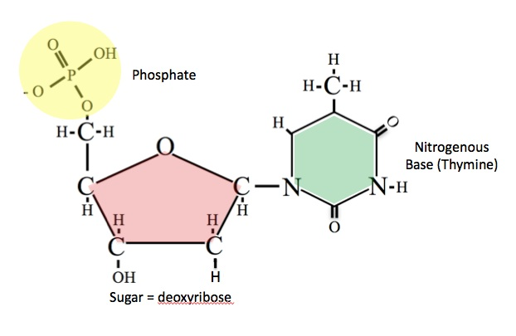
DNA: A Polynucleotide
Repeating unit in DNA is a nucleotide.
  Charged phosphate group attached to deoxyribose sugar.
  Nitrogenous base can be one of four components: Adenine, Cytosine, Guanine, or Thymine.
Additional Nucleotides can be added via Condensation Polymerization Here
Notes:
Having concluded the traditional discussion of polymers, the biopolymer DNA is introduced. DNA’s monomers, nucleotides, are defined. Furthermore, it is discussed that DNA is synthesized via the condensation polymerization mechanism discussed earlier in the lecture.

Slide 16
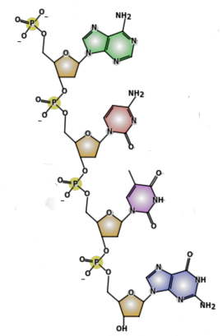
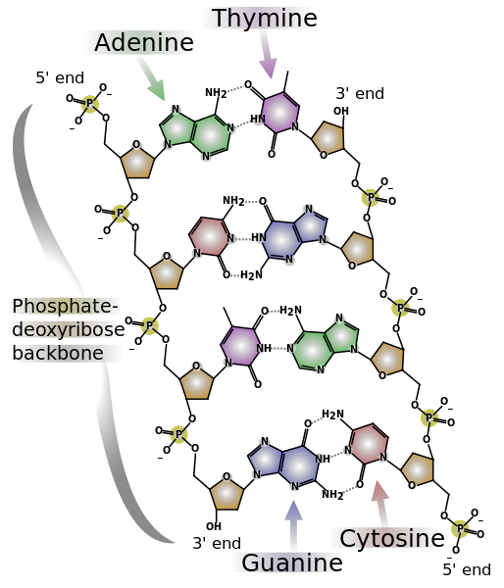
Building Single-Stranded DNA:
A High Information Content Polymer
Nucleotides are our building blocks.
Two components can be controlled:
  Length: The number of nucleotides.
  Base: The identity of the nucleotides.
5’: Ends with Phosphate
3’: Ends with Sugar
5’ end
Guanine
Cytosine
Thymine
Adenine
Note: These structures possess delocalized π orbitals and the ability to hydrogen bond.
3’ end
Notes:
The chemical structure of nucleotides and DNA is discussed on this slide. As will be discussed further in the following slide, the hydrogen bonding interactions (A with T and G with C) that lead to DNA-DNA hybridization are introduced.

Slide 17
Combining Single Strands
Specific combinations of nucleotides will “recognize” each other and connect via hydrogen bonding.
  We call this process hybridization.
  Adenine will connect to thymine
  via 2 H-bonds.
  Guanine will connect to cytosine
  via 3 H-bonds.
  Non-covalent connection (H-bond) means these can be broken and formed dynamically like in water.
Notes:
Since base-pairing was introduced on the previous slide, this slide defines DNA hybridization (duplex formation). DNA hybridization can be compared to the crosslinking in the traditional synthetic polymer, Kevlar.

Slide 18
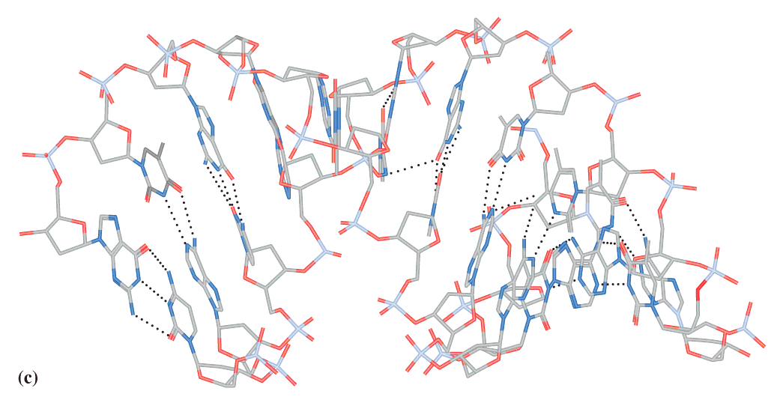
DNA Structure
DNA duplexes form a double-helix structure
  Nitrogenous bases are along the center and the charged phosphates are along the outside.
  Bases are stabilized in the center by π-π stacking: delocalized π orbitals overlap by stacking (similar to graphite).
Petrucci, Harwood, Herring, Madura, General Chemistry
Notes:
Now, having discussed hybridization, the structure DNA duplexes adopt, the double helix, is discussed. Here, it is noted that, within a double helix, the nucleobases are stabilized by π-π stacking and that this interaction is also found in a graphite (used in pencils).

Slide 19
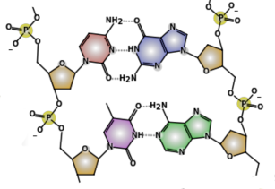
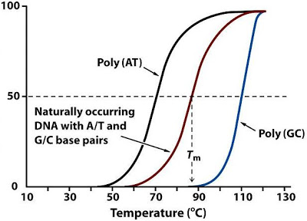
Dehybridization Requires IMFs to be Broken Between DNA Strands
The more bases that are complementary between single strands (and the more G-C content), the more intermolecular forces.
To separate these strands requires energy to break IMFs.
  Energy can come from the surroundings as temperature.
Normalized Absorbance
at 260nm
Notes:
On this slide, the relationship between the number of hydrogen bonding interactions in a DNA duplex and the physical properties of the DNA duplex (i.e., the melting temperature) is explored.

Slide 20

Q: Which of these DNA strands will have the greatest binding strength?
3’ AAGG 5’ and 5’ TTCC 3’
3’ AAGG 5’ and 5’ AAGG 3’
3’ GGCCGG 5’ and 5’ CCGGCC 3’
3’ TTACTA 5’ and 5’ AATGTT 3’
Chemistry 102: Petrucci, Harwood, Herring, Madura (Chapter 28)
Notes:
Having fully discussed the structures and interactions of single- and double-stranded DNA, a clicker question is included to encourage student discussion. With this question, the students’ understanding of DNA-DNA interactions, binding strengths, hydrogen bonding is assessed. Using this clicker question and the resulting discussion, the similarities and key differences between DNA-DNA bonds and the covalent bonds discussed earlier in the course are highlighted.

Slide 21
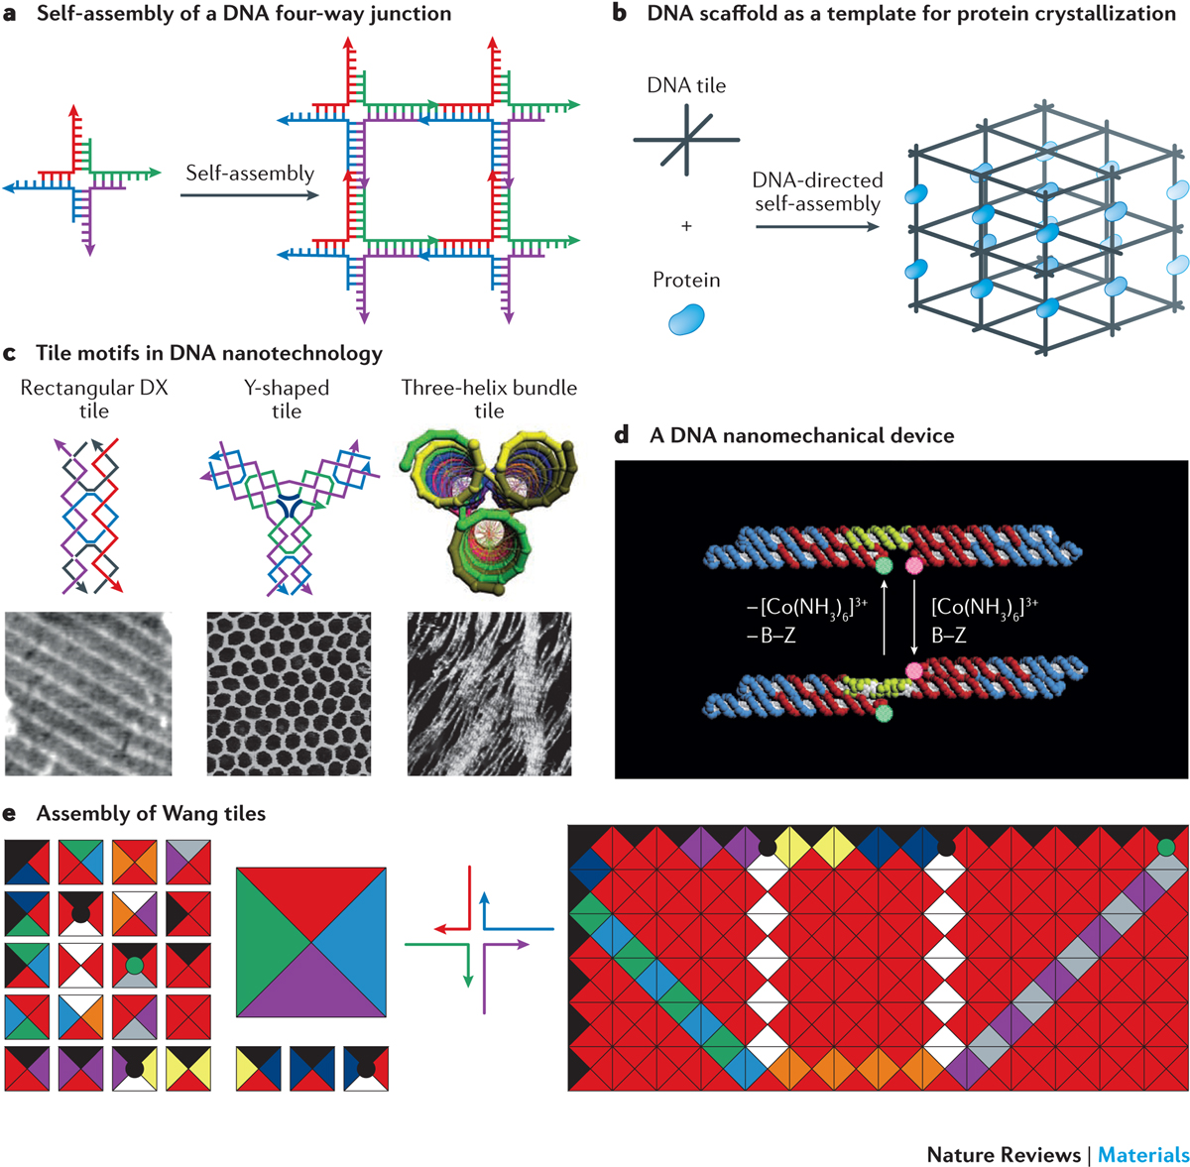
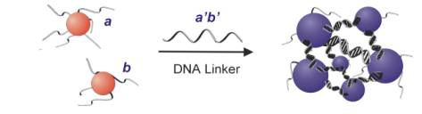
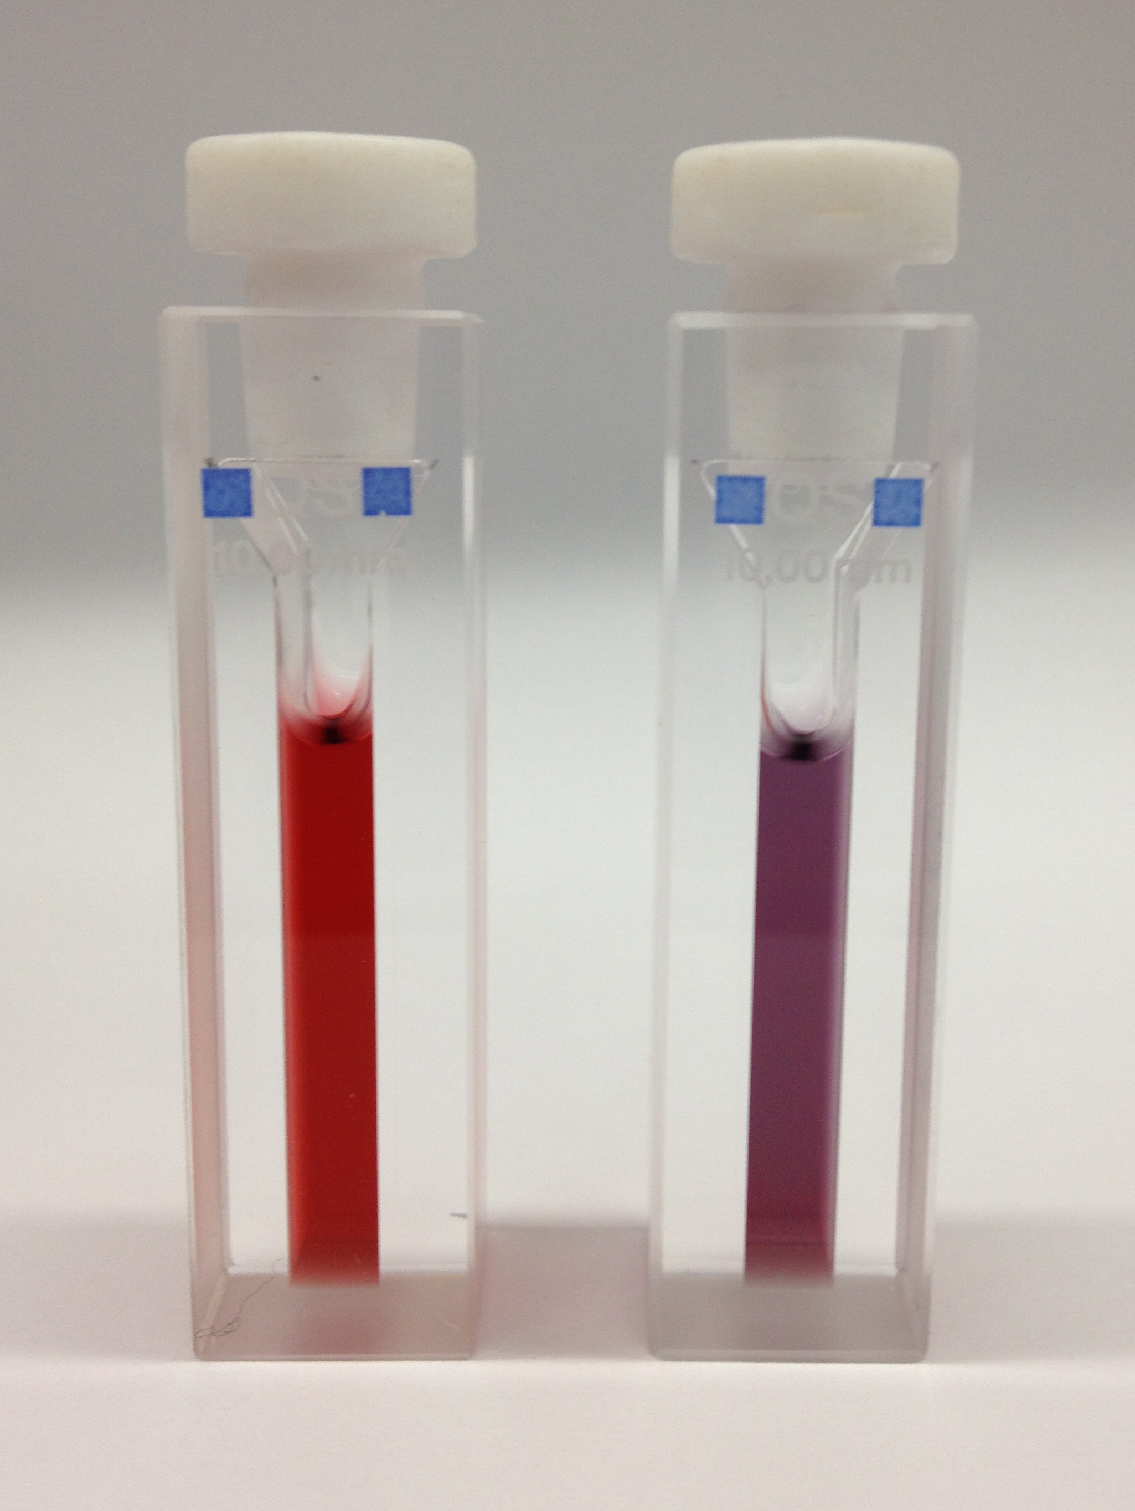
Uses of Synthetic DNA
(To Be Discussed Next Lecture)
Making designer materials – DNA Nanotechnology. Repurposing the blueprint of life for materials chemistry
Probes in biodetection -- measuring the presence or absence of a natural RNA or DNA sequence associated with a viral, bacterial, or genetic disease.
Genetic medicines – specific sequences can intercept cellular machinery like RNA to stop the production of disease-causing proteins.
Science, 1997, 277, 1078; J. Am. Chem. Soc. 2003, 125, 6, 1643; Nature Rev. Mater. 2018, 3, 17068.
Notes:
The lecture is concluded with a brief overview of the uses of synthetic DNA in the context of nanotechnology. For example, spherical nucleic acids (SNAs), nanostructures prepared using synthetic DNA, have been used as probes in biodetection and as genetic medicines. Note that, in the context of materials synthesis, the DNA on the surface of SNAs can be viewed as a “smart glue” rather than as a blueprint for life. This discussion leads directly into the topic of the next lecture - Nanomaterials.

